Slide 1
Staff Meeting
2/22/24

Slide 2
Agenda
Policies
Performance
Documents
Goals – Training
Upcoming
Tech tip: Signatures

Slide 3
Mileage
Employees may use their own vehicles for authorized travel and be reimbursed at the approved IRS rate in place at the time of the travel. For travel on college work days, mileage will be computed less the employee’s normal obligation to travel to and from his work station. On all other days, the mileage reimbursement will be computed based on the actual miles traveled.
My house to Chesapeake College = 14 miles.
My house to the Chestertown AJC = 37 miles.
I can charge mileage for 23 miles
Policies
MILEAGE

Slide 4
Leave
When planning leave time, such as vacation, please email me to let me know of the dates that you will be out. If you have access to the calendar, enter your leave there as well.
When calling out, you must text both Jackie and I to let us know. I will approve the leave, and Jackie needs to know who will be out for coverage.
Policies
LEAVE

Slide 5
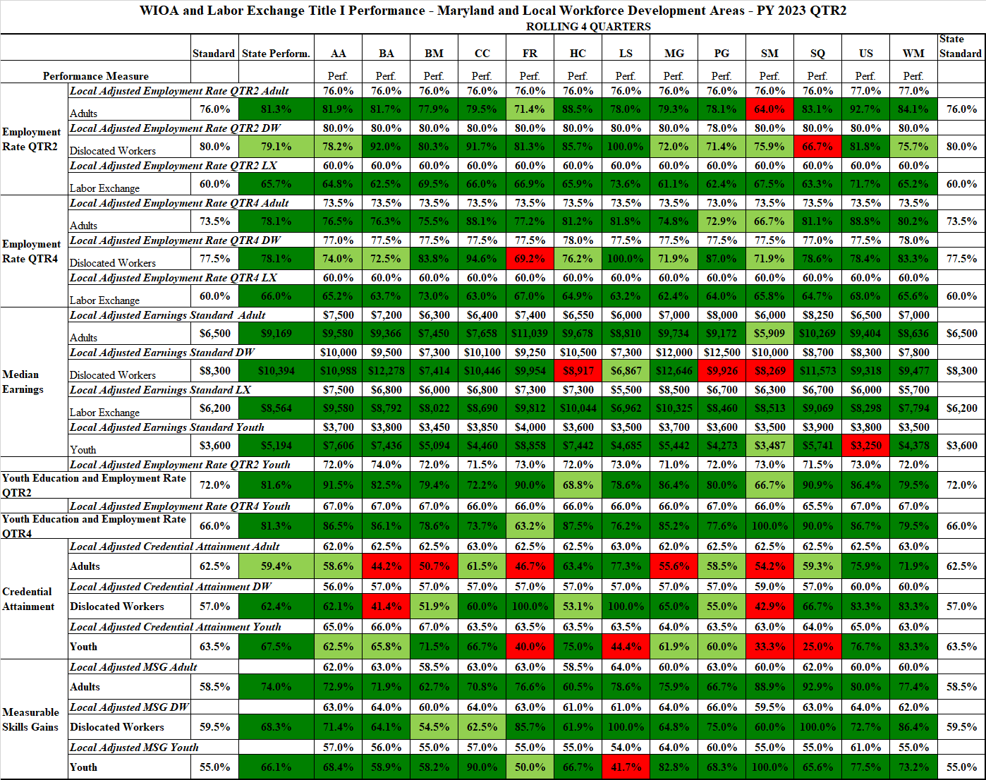
Performance

Slide 6
A reminder:
Do not request or accept documents emailed to you by a customer, especially items with Personally Identifiable Information (PII).
Customers are to upload documents to MWE on their own, or they are to come to the AJC to receive assistance.
Something to think about…
JP Morgan Chase, the largest US bank by assets, now fights off about 45 billion attempts a day by hackers trying to infiltrate its systems.
Documents

Slide 7
Updated documents on the staff webpage
Applicant statement: No changes to content. Added logo and header.
Complaint Procedures Application Acknowledgment Form: No changes to content. Added logo and header.
Documents

Slide 8
Please review your goals for this year. I will schedule brief meetings with everyone to discuss your progress.
Excel Training
Early Reminder-
Self-Evaluations are due by May 31st. This is to ensure that I have time to do the evaluations and meet to discuss them.
Goals

Slide 9
Internal Review/Audit
Artificial Intelligence Conference is April 5th
Job Fair
Upcoming

Slide 10
Signature lines can be used for emails that are sent on a regular basis.
Recommendation: Create email in Word first with your regular signature at the bottom. The information can be cut and pasted.
Tech Tips
SIGNATURE LINES

Slide 11
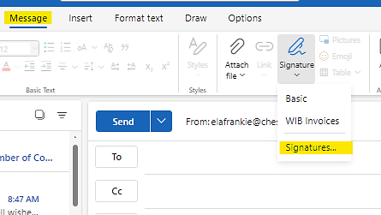
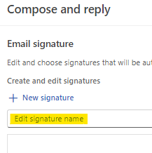
New Email > Message tab > Signature > Signatures
Tech Tips
SIGNATURE LINES
ONLINE
Click on “+ New Signature” > Edit signature name

Slide 12
Click on “+ New Signature” > Edit signature name
Copy and paste the message along with your regular signature line.
Tech Tips
SIGNATURE LINES
ONLINE

Slide 13
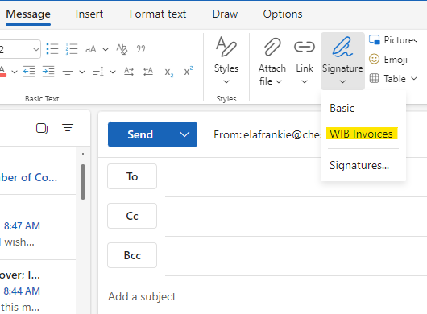
When you need to send an email with a message, create a new message. Then click on the signature with the email message that you want to send.
Tech Tips
SIGNATURE LINES
ONLINE

Slide 14
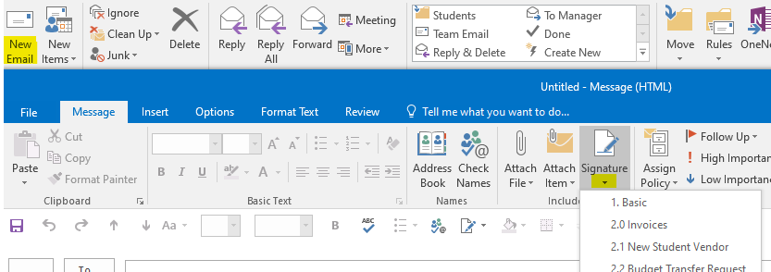
Click on New Email > Signature
The “Basic” signature is the one that you use with all emails.
Tech Tips
SIGNATURE LINES
DESKTOP

Slide 15
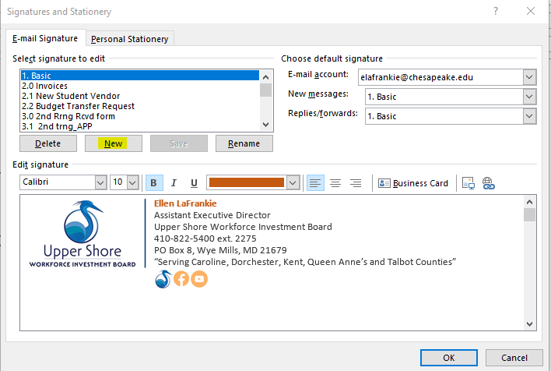
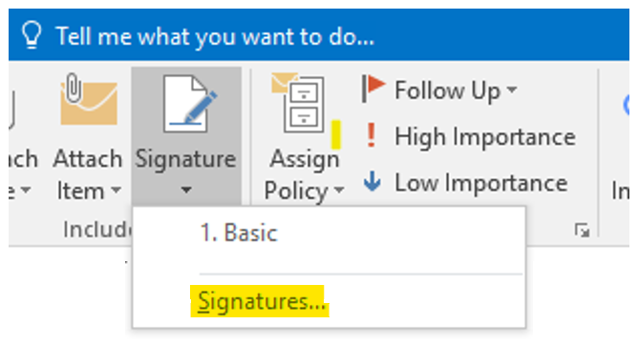
Click on “Signatures…” to create a new signature.
Click on the “New” button to write the new signature.
Tech Tips
SIGNATURE LINES
DESKTOP

Slide 16
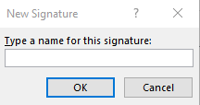
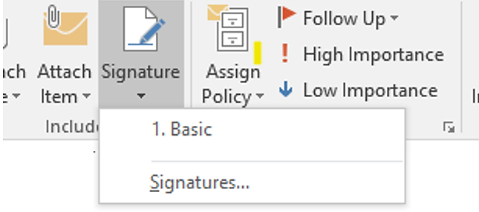
Type a name for the signature.
Copy and paste your message with your email signature and then click save.
When you create a new message, you can click on the triangle under signature and then select the signature/message you want.
Tech Tips
Signature Lines
DESKTOP

