Slide 1
Outlook & File Tips
WIB Staff meeting: December 2023

Slide 2
Outlook & File Tips
Calendar
Expense Statement Forms
File Naming Tips

Slide 3
Outlook Calendar
Some good guidelines:
Email the person/agency to suggest a meeting and to give/ask for availability.
Once the person’s availability has been established, send a calendar invite.

Slide 4
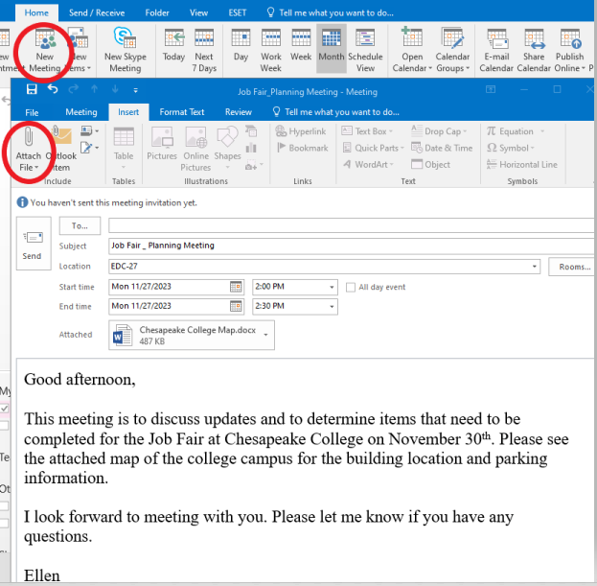
Outlook Calendar
DESKTOP
Click on new Meeting & complete the To, the Subject, the Location, the Start/End Time, and Body of the Message.
Click on the “Insert” tab and then “Attach File” if you would like to attach a document (map, agenda) to the invite.

Slide 5
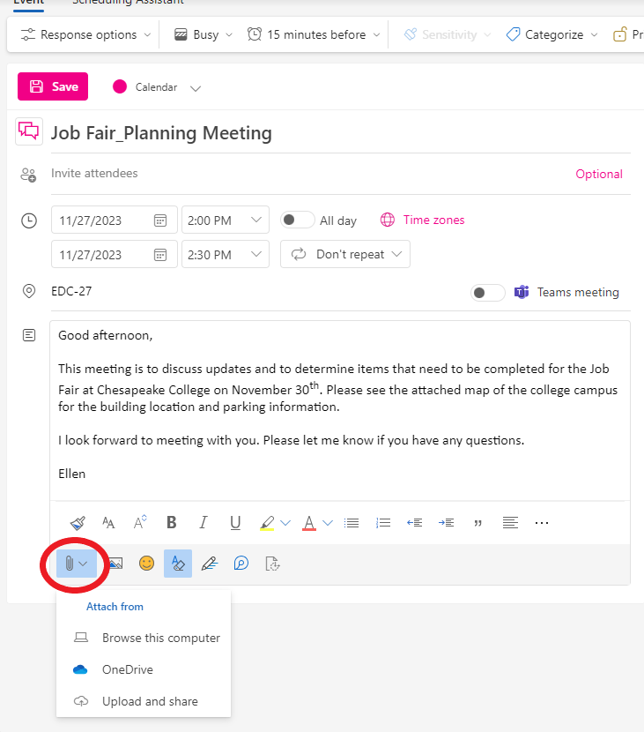
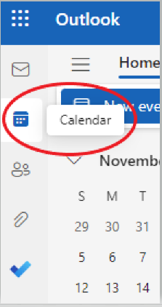
Outlook Calendar
ONLINE
Click on the calendar icon to open an invitation.
Enter the attendees, times, location, and include information in the body.
Click on the paperclip icon to attach files.
Click on “Save” when finished.

Slide 6
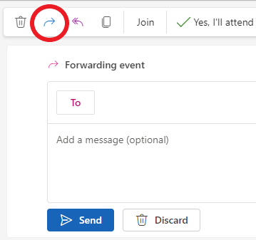
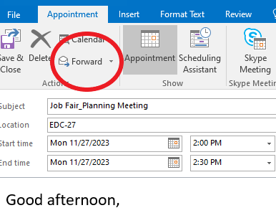
Outlook Calendar
Calendar Invites can be forwarded
DESKTOP
ONLINE
Click on the “Appointment” tab and then click on “Forward”.
Click on the blue arrow icon at the top of the event.

Slide 7
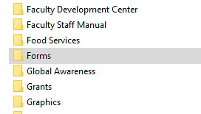
Expense Statement Forms
Go into cchest
Go into the Public Folder.
"Q:\Public\Forms"
Scroll down to the “Forms” Folder.
Click on the “Chesapeake Forms” Folder
The newest Expense Statement is in the folder.

Slide 8
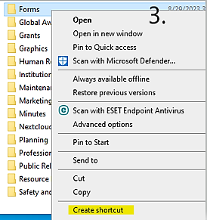
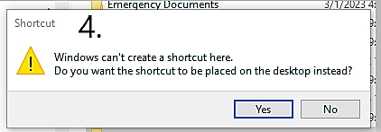
Expense Statement Forms
Creating a shortcut to the form
Go to cchest.
Then click on the “Public Folder”
Right click on the “Forms” Folder and click on “Create Shortcut”
You’ll get a “Windows can’t create a shortcut here. Do you want the shortcut to be placed on the desktop instead message.” Click on the “Yes” button.
The shortcut will not be on your desktop.

Slide 9
File Naming Tips
Examples of files that are too generic:
Test data 2016.xlsx
Meeting notes Jan 17.doc
Notes Eric.txt
Final FINAL last version.docx
Doc1

Slide 10
File Naming Tips
Things to think about:
Would someone else be able to find the file?
Would someone else understand what the file is by reading the title?
Some tips for naming files:
Think of the topic
What type of document is it (report, agenda, form…)
When did you receive or create the document?
Be consistent with titles.

Slide 11
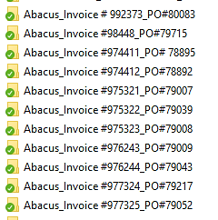
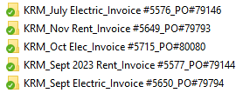
File Naming Tips
Examples:
Name of the folder
FINANCIAL_Invoices, Reqs, PO
File Names
Company name_Invoice #_PO#

